Slide 1
English Land
The Adventure
in Space

Slide 2
What’s your name?
Write your name for your future friends

Slide 3
Find the odd one
Guinea pig, fox, Belarus, budgie, kitten
dog, rabbit, family, bus, brown
black, orange, green, blue, dad
Apple, mum, cucumber, cheese, bread
Eyes, nose, hair, love, ears

Slide 4
Guinea pig, fox, Belarus, budgie, kitten
dog, rabbit, family, bus, brown
black, orange, green, blue, dad
Apple, mum, cucumber, cheese, bread
Eyes, nose, hair, love, ears

Slide 5
Belarus, mum, dad , love, family
I am from …..
I’ve got a big…..
I have a…… She is nice.
I have got a…. He is kind.
I …..my family.

Slide 7
Riddles
It’s brown. It’s got long ears and a big
mouth. It’s got a black nose. It can jump and run.
It can swim. It can’t fly.

Slide 9
Riddles
It’s grey. It’s got long ears and a little
mouth. It’s got little black eyes. It’s got a pink
nose. It can jump and run. It can’t swim. It can’t
fly.

Slide 11
Riddles
It’s yellow and brown. It’s got little ears
and a little mouth. It’s got a little nose. It can
walk and swim. It can’t jump or run. It can’t fly.

Slide 13
Riddles
It’s grey ,brown,black and white. It’s got little ears and
a little mouth. It’s got a pink nose. It can walk,
jump and run. It can climb a tree. It
can’t fly.

Slide 14
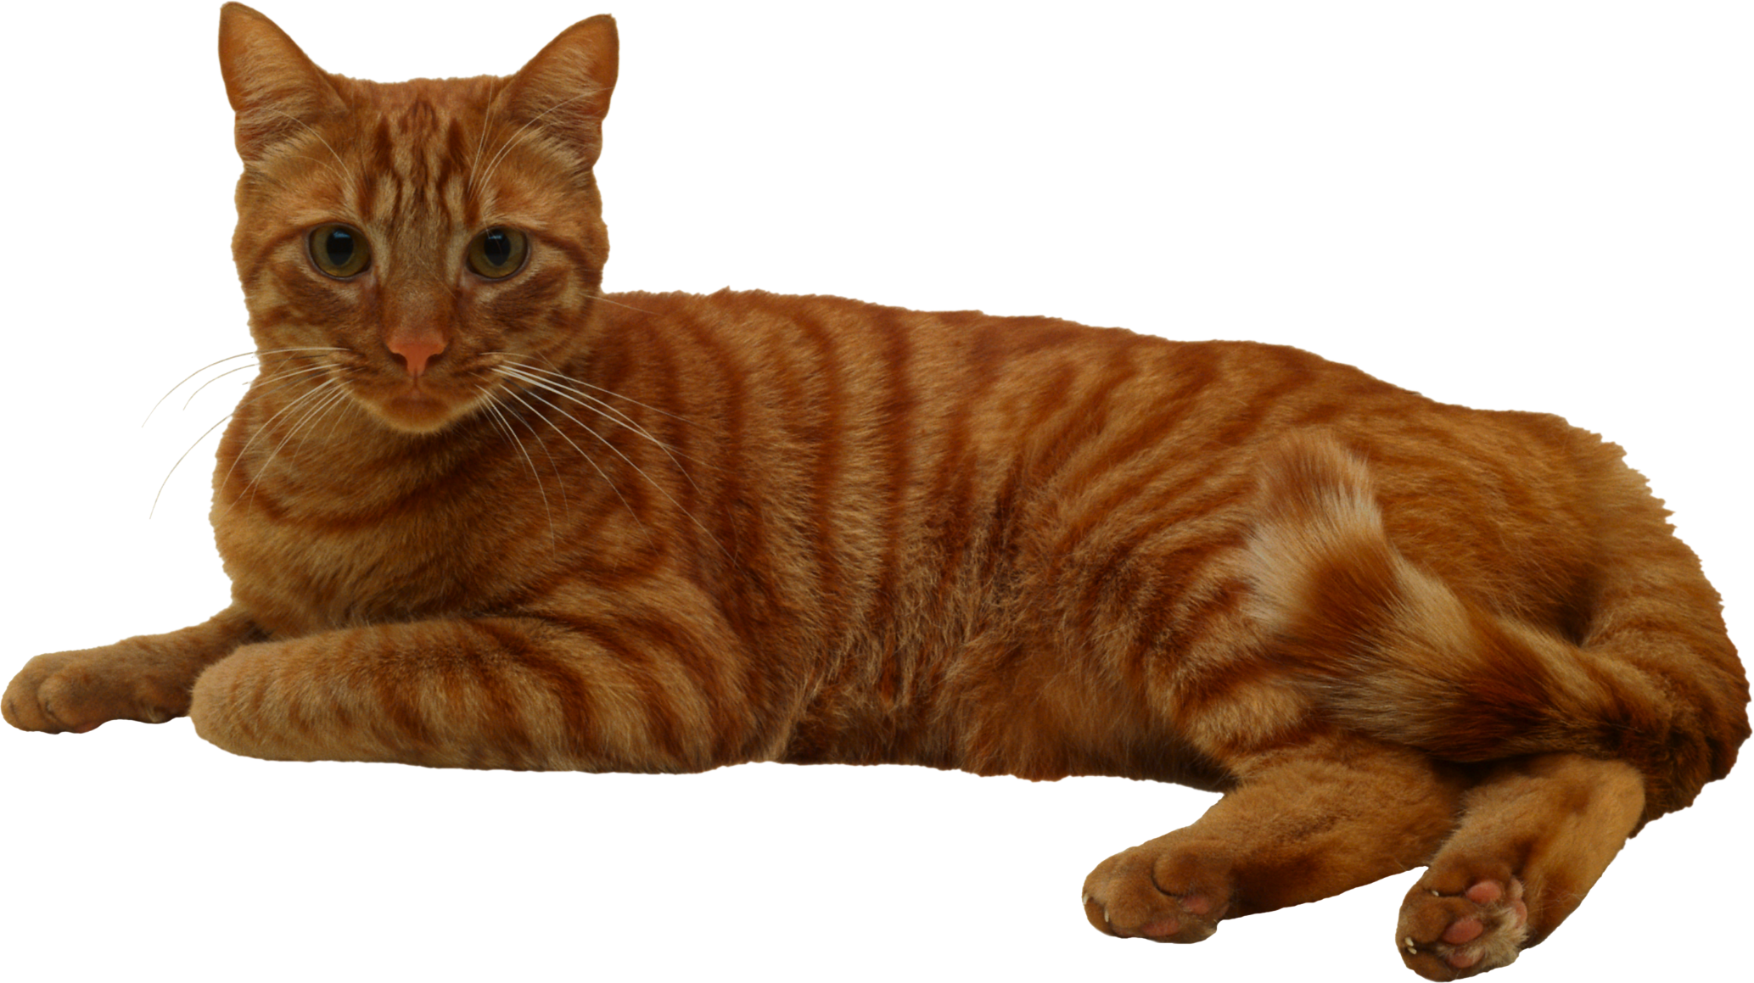

Slide 15
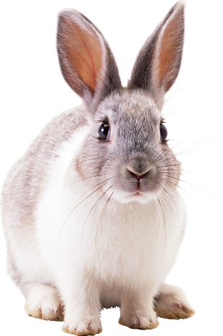
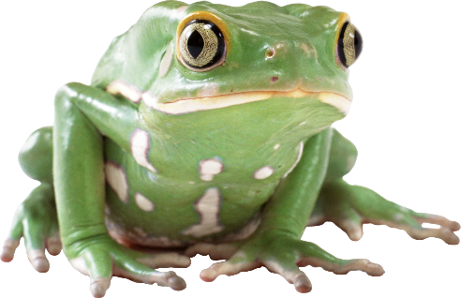
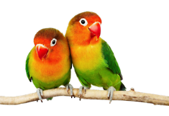
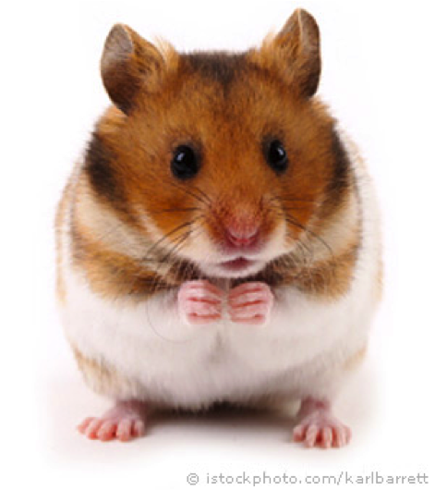
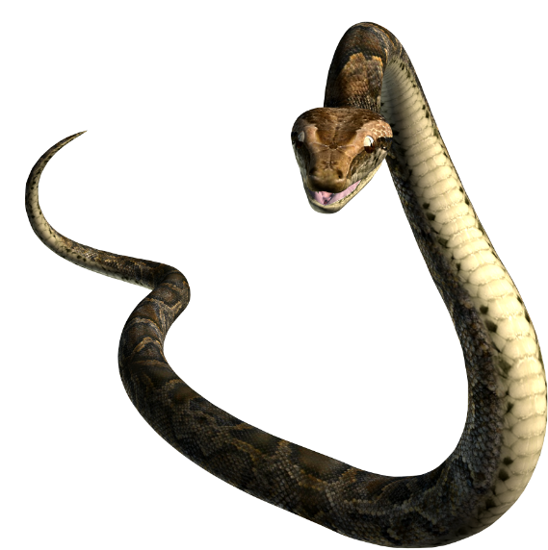
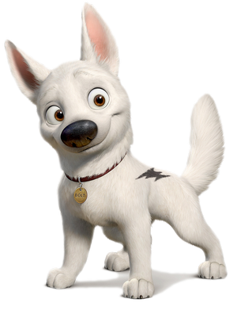
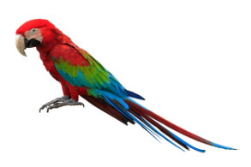
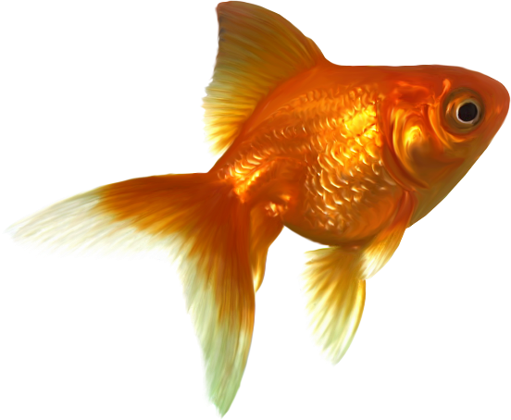
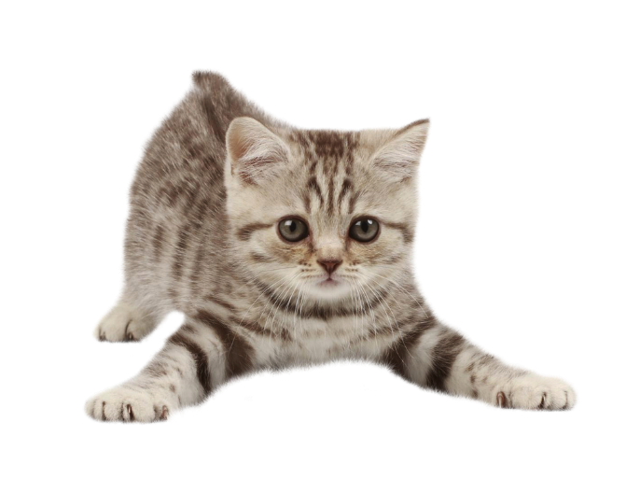
Crossword
9
8
2
5
4
7
6
3
1

Slide 18
Make a recipe
I’ve got some…. To make a cake
I’ve got some…. To make some soup

Slide 20
Are you clever??? Do the sums!
9-6+2= 4+2-0= 0+8-7=
5+2-4= 7-5+0= 8-6+2=
4+5-1= 8-5-3= 1+2+4=
6-2+5= 3+1+4= 5+1-3=

Slide 21
Make a sentence
Do,like, sweets,?, you
Got,have,a , family, big, I
My,can, and,swim,run,dog
I, cheese, any, haven’t, got
Have, blue, I, got , eyes

Slide 23
Let our rocket fly

Slide 24
Thanks for coming!

